Slide 1

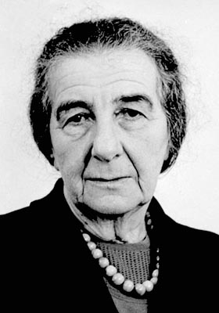
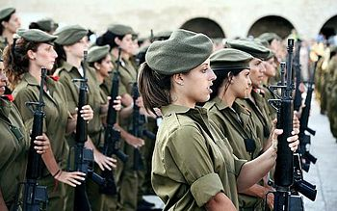
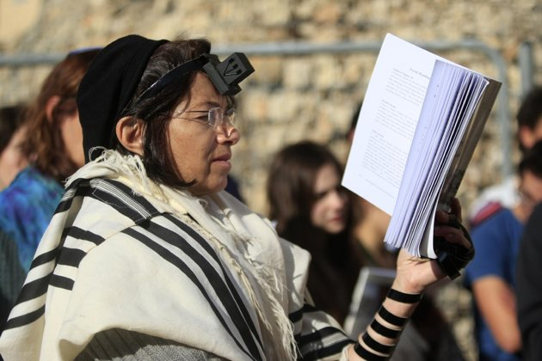

Women in Israeli History
Department for Diaspora Activities -North America
המחלקה לפעילות בתפוצות- צפון אמריקה
www.izionist.org/NA

Slide 2
Status of Women in Israel: Roots in Zionism
Two Trends:
Zionism was essentially a masculine liberation movement
On the other hand, the harsh conditions of the pioneers and the need to settle the land led to equality with regard to labor and security
Women were expected to “assimilate” rather than “adapt.” They were expected to work and act like men as opposed to adapting society to integrate work and family.
Department for Diaspora Activities -North America
המחלקה לפעילות בתפוצות- צפון אמריקה
www.izionist.org/NA

Slide 3
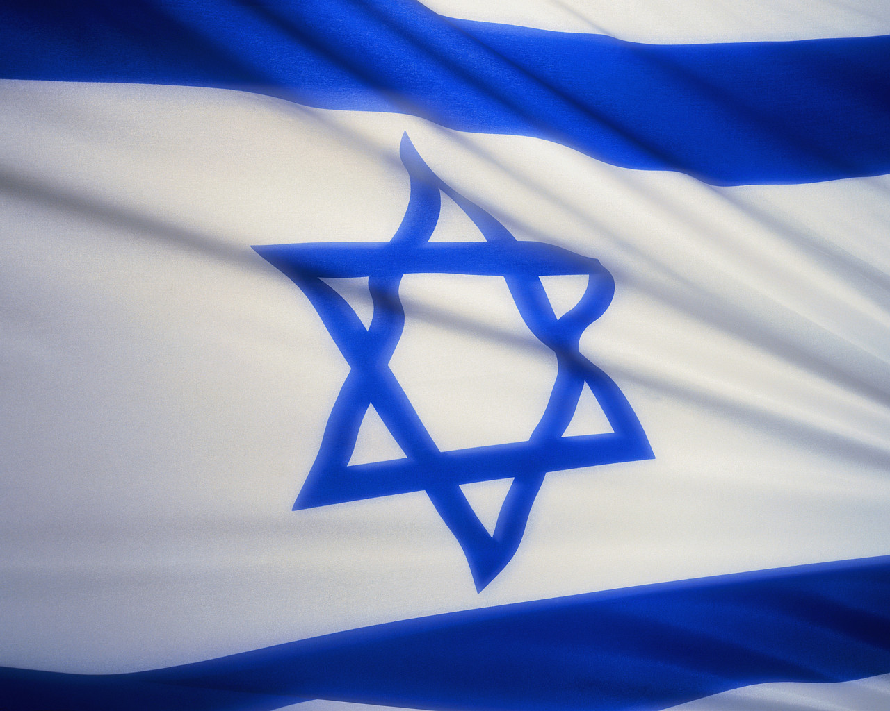
1948: The Establishment of the State of Israel
On May 14, 1948, David Ben Gurion declared Independence for the State of Israel. During that speech, he declared all citizens equal.
“…uphold the full social and political equality of all its citizens, without distinction of race, creed, or sex…”
However, this ideology was not put into practice immediately.
David Ben Gurion became Israel’s first Prime Minister and emphasized the importance of increasing the Jewish population in Israel to strengthen the state. He encouraged women to “be fruitful and multiply” and focus on their roles as mothers.
Department for Diaspora Activities -North America
המחלקה לפעילות בתפוצות- צפון אמריקה
www.izionist.org/NA

Slide 4
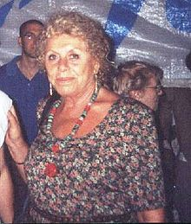
Feminism in Israel
Shulamit Aloni is considered the founder of feminism in Israel
  She founded the Ratz party in 1973—the first party to champion the causes of human and civil rights and the advancement of women
The establishment of the Knesset Committee on the Status of Women (1992), emphasized the empowerment and advancement of women in the workplace
Department for Diaspora Activities -North America
המחלקה לפעילות בתפוצות- צפון אמריקה
www.izionist.org/NA

Slide 5
Women in the Workforce
In Israel, approximately 50% of women participate in the workforce, as opposed to 62% of men
However, for the Israeli Arab population, severe unemployment is a major issue for women
  Only 22% of Arab women work
  Women residing in peripheral regions and middle-aged women aged 45-64 suffer from low unemployment as well
Women also face a large salary gap. The salary discrepancies between male and female workers are approximately 25% in public sector and 35% in the private sector
However, women’s rights in regards to pregnancy and birth are far from ignored.
  Maternity leave is 14 weeks
  Women working prior to pregnancy cannot be fired and receive full salary
Department for Diaspora Activities -North America
המחלקה לפעילות בתפוצות- צפון אמריקה
www.izionist.org/NA

Slide 6
Women in Politics
In Israel, the representation of women in the Knesset, the government, and municipal authorities is very low in comparison with other democracies
Although it passed the 10% barrier in 2000, the maximum representation of female members in the Knesset was 18%
Israel is ranked 100th place among the nations of the world, falling far behind European, South American, Asian, and African countries
Aside from having a woman Prime Minister, Golda Meir, in the 1970s, Israel is still far behind its competing countries in progression of women in government
  It is important to not that Meir, while breaking the barrier for Israeli women, was an exception and did not advance a feminist agenda as Prime Minister
Department for Diaspora Activities -North America
המחלקה לפעילות בתפוצות- צפון אמריקה
www.izionist.org/NA

Slide 7
Women in Judaism
In Judaism, the status of women is open to interpretation:
“God created man in His image, in the image of God He created him; male and female He created them” (Gen. 1:27).
  This interpretation claims that using male, female, and them suggests full equality.
“And the Lord God fashioned the rib that He had taken form the man into a woman—and He brought her to the man. Then the man said, ‘This one at last is bone of my bone and flesh of my flesh. This one shall be called Woman (אישה) for she was taken from man (איש)’” (Gen. 2:22-23).
  This interpretation claims that woman is “only” a rib of man, and the superiority of man is thereby legitimized.
Department for Diaspora Activities -North America
המחלקה לפעילות בתפוצות- צפון אמריקה
www.izionist.org/NA

Slide 8
Women and Religious Freedom
Unlike the U.S., because Israel is both a democratic state and a Jewish state, religion and government overlap
This impacts the character and legislation of Israel, especially with regard to the relationship between religious and secular Jews
The Rabbinical Court’s Jurisdiction Law of 1953 placed the authority for marriage and divorce in the hands of the Orthodox religious establishment
There is a struggle over pluralism within Judaism:
  Israel recognizes the Orthodox streams of Judaism
  The Reform and Conservative movements are forced to fight for recognition
Department for Diaspora Activities -North America
המחלקה לפעילות בתפוצות- צפון אמריקה
www.izionist.org/NA

Slide 9
Women and Religious Freedom:
Failures
Every year, a proposal to certify civil marriage and divorce as an alternative to religious marriage is raised in the Knesset
There is a struggle to return the social article to the Abortions Law, according to which women may abort for social reasons and not just health reasons
There is a struggle over the right of women to pray at the Western Wall
There is a struggle over the right of women to serve as Rabbis
There is a struggle against separate seating for men and women on buses
Department for Diaspora Activities -North America
המחלקה לפעילות בתפוצות- צפון אמריקה
www.izionist.org/NA

Slide 10
Women and Religious Freedom:
Achievements
The establishment of family courts in 1994 abrogated the exclusive control of the rabbinical courts
The advancement of legislation to rescue ‘chained women’ (agunot) from their husbands’ refusal to grant a divorce
The increased number of Ultra-Orthodox women in higher education, especially due to the establishment of Ultra-Orthodox colleges for women
Increased steps to professionally train and integrate Ultra-Orthodox women into the workforce
Department for Diaspora Activities -North America
המחלקה לפעילות בתפוצות- צפון אמריקה
www.izionist.org/NA

Slide 11
Arab Women in Israel
Arab women suffer from a double dose of discrimination: both as Arabs (who make up only 20% of the total Israeli population), and as women
Their participation in the workforce is a mere 22%, less than half of the figure for Jewish women, severely hampering their growth and integration into society and politics
The patriarchal culture of Israeli Arabs has been slower to unravel than in the Jewish sector. Concepts such as “honor killings,” “ownership and control of the wife by the husband”, and arranged marriages are more common
Department for Diaspora Activities -North America
המחלקה לפעילות בתפוצות- צפון אמריקה
www.izionist.org/NA

Slide 12
Women in the IDF
The patriarchal worldview views men as fighters and nurturers
Women’s movements have called this “social order” into question, with two main objectives:
On one hand, the feminist movement generally opposes war and militarism, and instead emphasizes values of humanism, finding common ground, and mediation
On the other hand, women have claimed that as long as countries have militaries, service should be open to women as well to ensure equality and to refine the behavior of combatants in training and in battle
Department for Diaspora Activities -North America
המחלקה לפעילות בתפוצות- צפון אמריקה
www.izionist.org/NA

Slide 13
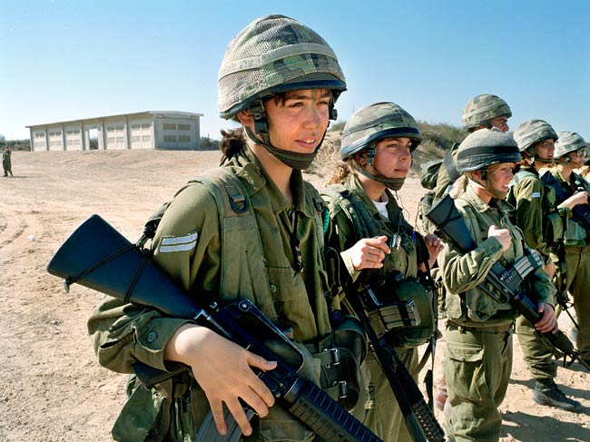
Women in the IDF, cont.
Israel is the only country in the world with compulsory military service for all men and women when they reach the age of 18, or complete their studies
Men serve 36 months and women serve 20 months
The 1986 Defense Service Law establishes that religious women are exempt from military service. Those who wish may enlist in the National Service, where they are active in community service
Department for Diaspora Activities -North America
המחלקה לפעילות בתפוצות- צפון אמריקה
www.izionist.org/NA

Slide 14
Women in the IDF:
The Case of Alice Miller
In 1995, Alice Miller, together with the Women’s Lobby and women Knesset members, led a campaign against the IDF over her right to join flight training.
The IDF argued that women were physically incompatible for the flight course, and that the State would have to shoulder a large cost to adapt the program for women.
The High Court of Justice ruled that the principle of equality, which comprises one of the state’s cardinal values, justifies and demands the financial investment
Since 1995, the flight course, and in its wake the Shayetet Naval Sepcail Force Unit, now enlists women
In 2000, a law was passed requiring the IDF to open combat service roles to thousands of women
Department for Diaspora Activities -North America
המחלקה לפעילות בתפוצות- צפון אמריקה
www.izionist.org/NA

Slide 15
Achievements in the Advancements of Women in Israel
The entry of women into the labor market broadening their importance in all sectors
Israel’s legislation is amongst the world’s most progressive, raising awareness, oversight, and institutionalizing supervision
Providing greater protection to women by intensifying the struggles against violence towards women, sexual harassment, and the trafficking in women
Strengthening the voice of women in social-cultural formation; women in literature, the media, religion, peace, and war
Department for Diaspora Activities -North America
המחלקה לפעילות בתפוצות- צפון אמריקה
www.izionist.org/NA

Slide 16
Achievements in the Advancements of Women in Israel, cont.
Approaching equality in the number of students in higher education, including doctoral students, and instituting Gender Studies
Advancement of sexual equality in the military; this constitutes the jumping-off point for women into their civilian lives
Supreme Court rulings on representations of women in religious councils, a flexible retirement age for working women, affirmative action and others precedents that have expanded women’s rights
Department for Diaspora Activities -North America
המחלקה לפעילות בתפוצות- צפון אמריקה
www.izionist.org/NA

Slide 17
Challenges to the Advancement of Women in Israel
The failure to embrace the idea that the development of women has potential for the society and the state
Slowing of the process of integration of women into the workplace; Arab women, making the retirement age earlier, part-time work
The continued existence of pay gaps in the public and private sectors and the failure to raise minimum wage
The perpetuation of a glass ceiling preventing women from reaching senior positions in the public and private sector
Department for Diaspora Activities -North America
המחלקה לפעילות בתפוצות- צפון אמריקה
www.izionist.org/NA

Slide 18
Challenges to the Advancement of Women in Israel, cont.
No separation of religion and state in matters of personal status
Under-representation politically; on the national level and in municipal authorities
Slow assimilation, cultural change, and educational processes that promote the value of women’s equality
Department for Diaspora Activities -North America
המחלקה לפעילות בתפוצות- צפון אמריקה
www.izionist.org/NA

Slide 19
Conclusion
Overall, the status of women in Israel has advanced greatly, especially during the 1990s
Nevertheless, the status of women in the future will be decided not only by feminist perspectives, but by the public policy that Israel adopts
Department for Diaspora Activities -North America
המחלקה לפעילות בתפוצות- צפון אמריקה
www.izionist.org/NA

