Slide 1
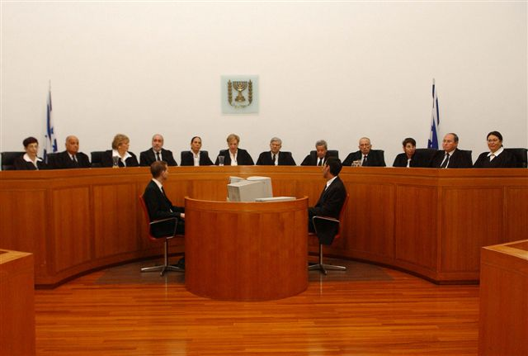
Judicial activism in Israel: The supreme court involvement in defending the Jewish and Democratic identity of the State of Israel.

Slide 2
The Declaration of the Establishment of the State of Israel, mentions a draft constitution to be prepared by a constitutional committee and to be adopted by an elected constituent assembly not later than October 1948.
After convening on February 14, 1949, the Constituent Assembly, however, instead of drafting a constitution, on February 16 converted itself into a legislative body (the first Knesset)
The reason for the failure:
primarily for fear that a constitution would unleash a divisive conflict between religious and state authorities.

Slide 3
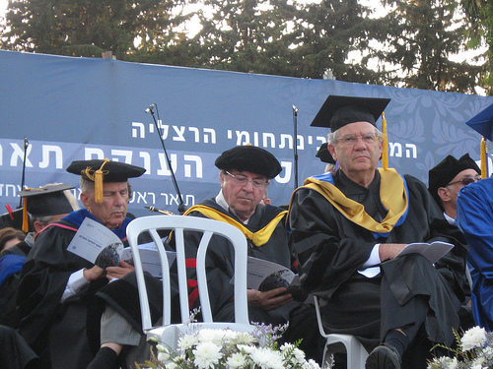
Proponents argued that constitution would:
ensure religious freedom, minority rights, equal rights and civil liberties.
safeguard the principle of the separation of powers and,in a period of rapid immigration, referred to in Israel as the "ingathering of exiles," would be a unifying factor, unequivocally establishing the supremacy of civil law.

Slide 4
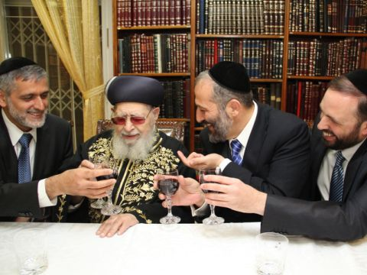
Opponents contended that:
the domestic and external circumstances of Israel in 1949 were not auspicious for the adoption of a constitution.
They stressed that a written constitution would be politically divisive because the controversial issue of the boundaries between state and religion would inevitably be raised in formulating the principles, goals, and nature of the state as codified in a constitution.

Slide 5
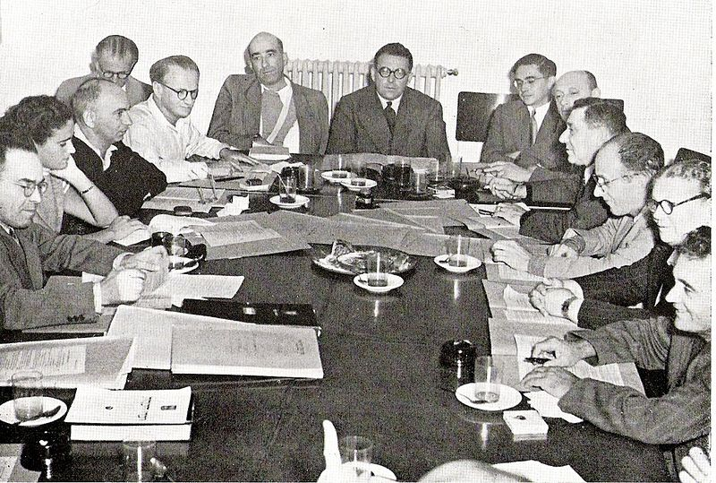
Harari decision
The Israeli solution to the lack of a constitution has been a "building-block" method.
In June 1950, the Knesset passed a compromise resolution, known as the "Harari decision“- approving a constitution in principle but postponing its enactment until a future date. The resolution stated that the constitution would be evolved "chapter by chapter in such a way that each chapter will by itself constitute a fundamental law."

Slide 6
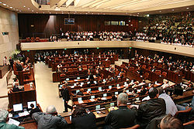
The Basic Law until 1988
By 1988 nine Basic Laws had been enacted to deal with the Knesset (1958):
Israeli Lands (1960) the Presidency (1964) the Government (1968) the State Economy (1975) the Army (1976) Jerusalem (1980) the Judiciary (1984) Elections (1988)

Slide 7
1992 – The Knesset legislatived 2 basic laws – the constitutional revolution is about to begin.
Human Dignity and Liberty is a Basic Law, intended to protect main human rights in Israel. the Knesset gave these two laws super-legal status, giving the courts the authority to disqualify any law contradicting them.
According to this claim (which is not supported by all) these laws marked a substantial change in the status of human rights in Israel.

Slide 8
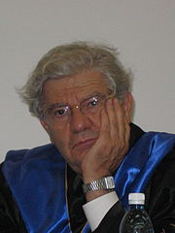
Aharon Barak
President of the supreme Court of Israel
In office 13 August 1995 – 14 September 2006
According to Barak's approach, which was adopted by the Supreme Court, the Constitutional Revolution brought values such as the Right to Equality, Freedom of Employment and Freedom of Speech to a position of normative supremacy, and thereby granted the courts the ability to strike down legislation which is inconsistent with the rights embodied in the Basic Laws.

Slide 9
Many parliament members argue that the supreme court has no right to disqualify laws because this involvement over the parliament harms the public will and the Rule of the People.
conflicting values
Jjlnlsupervision
and limitation
over the parliament and the government
Rule of the people, The Knesset should decide

